Slide 1
Little Wandle
Early Reading information

Slide 2
Why are we moving to Little Wandle?
‘Teach reading and change lives’
That every child should be supported to read and love it.
Little Wandle Letters and Sounds Revised reflects the latest evidence-based understanding of how children learn.
Focused attention | Active engagement | Error feedback | Practice and consolidation

Slide 3
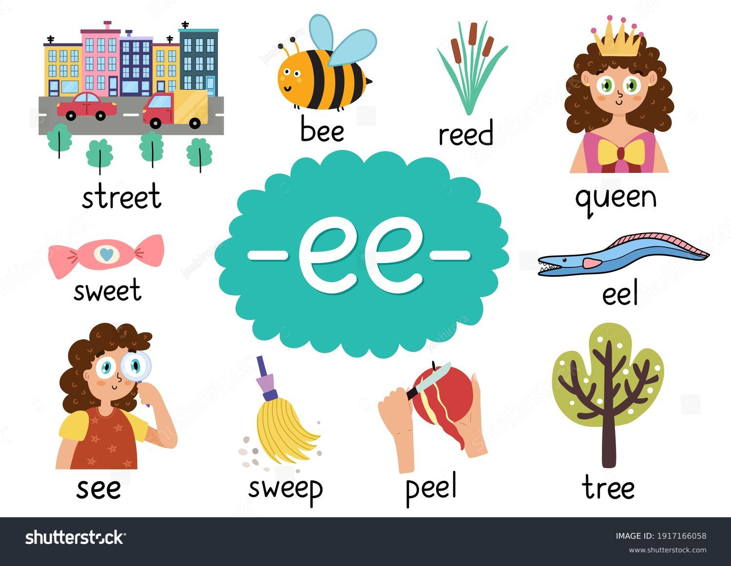
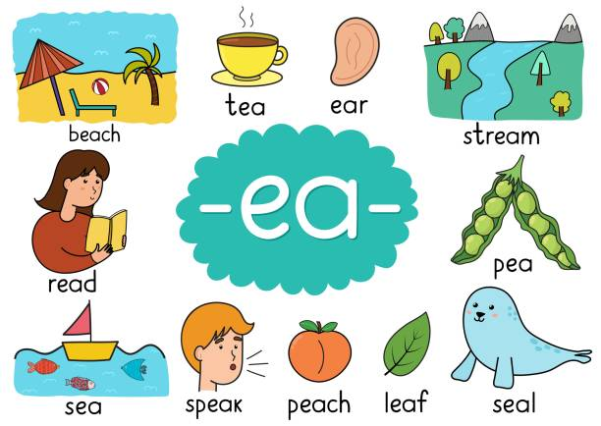
What is phonics?
→ Making connections between the sounds of our spoken words and the letters that are used to write them down.

Slide 4
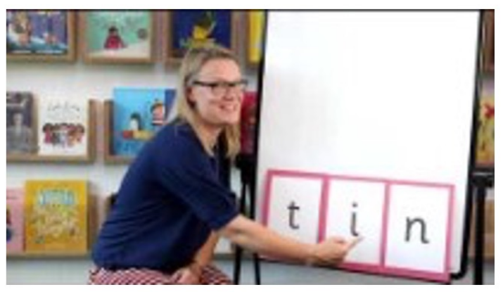
Blending
The process of joining together one or more sounds in order to read a word.
Starts with oral blending, then moves on to reading.

Slide 5
Little Wandle online
Support for phonics
How we teach
Books coming home
Nursery rhymes – videos
Nursery rhymes - downloads
https://www.littlewandlelettersandsounds.org.uk/resources/for-parents/#tabnametabSupportForPhonics

Slide 6
Home reading
1) Decodable books - Reading books that are matched to your child’s phonics level, meaning they include the sounds they have been taught and there shouldn’t be any unknown sounds.
These are the same book your child will have read the previous week in their Little Wandle reading squad sessions.
Accessed via the E-Library.
Login details will be sent home in September.
https://ops.collinsopenpage.com/sso/login?service=https%3A//ebooks.collinsopenpage.com/wr/index.html&eulogin=true
Notes:
This book has been carefully matched to your child’s current reading level. If your child is reading it with little help, please don’t worry that it’s too easy – your child needs to develop fluency and confidence in reading.
Listen to them read the book. Remember to give them lots of praise – celebrate their success! If they can’t read a word, read it to them. After they have finished, talk about the book together.
Later in the year, there will be an AR book sent home. Your child will take quizzes to determine their level and then quizzes after they have read a book to assess their understanding. This will not be until later in the year (at least after Christmas).

Slide 7
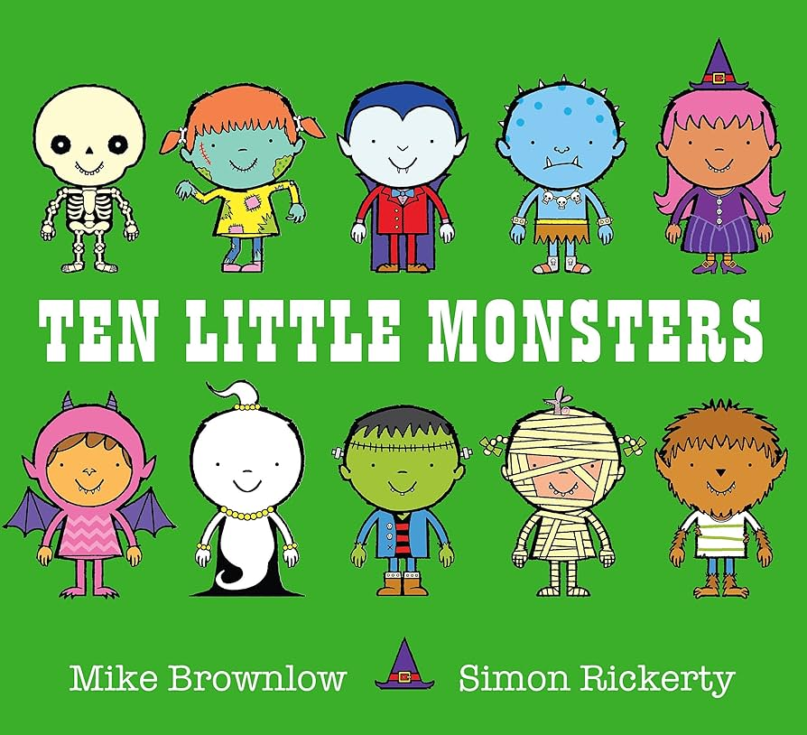
Home reading
2) ‘Share with me’ book. Your child will not be able to read this on their own. This book is for you both to read and enjoy together.
Notes:
In order to encourage your child to become a lifelong reader, it is important that they learn to read for pleasure. The sharing book is a book they have chosen for you to enjoy together.
Please remember that you shouldn’t expect your child to read this alone. Read it to or with them. Discuss the pictures, enjoy the story, predict what might happen next, use different voices for the characters, explore the facts in a non-fiction book. The main thing is that you have fun!

